Slide 1
Sentence Embeddings
Understanding the Foundation of SBERT

Slide 2
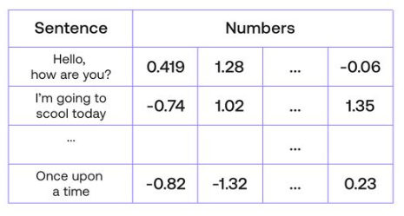
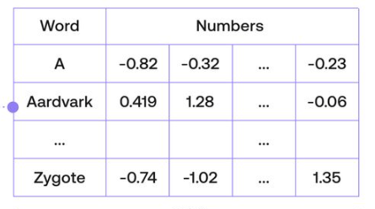
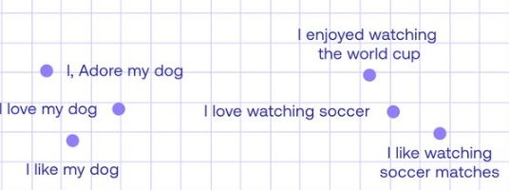
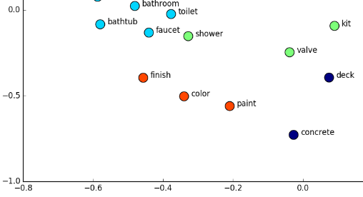
What are Sentence Embeddings?
Sentence embeddings are numerical representations of sentences, capturing their meaning in a high-dimensional space.
https://txt.cohere.com/sentence-word-embedding
https://neptune.ai/blog/word-embeddings-guide

Slide 3
Role of Sentence Embeddings in NLP
Key Role in NLP:
Sentence embeddings are crucial for understanding the meaning and context of text in NLP.
They provide a way to quantify and compare whole sentences/documents beyond individual words.
NLP Tasks Enhanced by Sentence Embeddings:
Semantic textual similarity (STS) — comparison of sentence pairs.
Finding Questions similar to the New Question
Semantic search — information retrieval (IR) using semantic meaning. Given a set of sentences, we can search using a ‘query’ sentence and identify the most similar records. Enables search to be performed on concepts (rather than specific words).
Clustering — we can cluster our sentences, which is useful for topic modeling.

Slide 4
W2VEC to Sentence Embeddings
No: [1,0,0,0]
I: [0,2,0,0]
Am: [-1,0,1,0]
Good: [0,0,1,3]
“No, I am good!” – [0,2,2,3]
“I am No good!” – [0,2,2,3]
https://txt.cohere.com/sentence-word-embedding

Slide 5
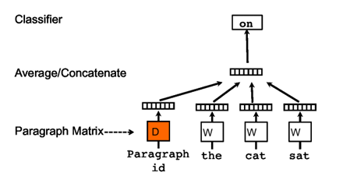
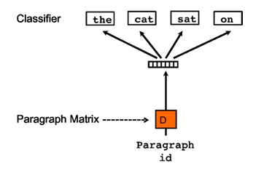
Doc2Vec
https://arxiv.org/abs/1405.4053

Slide 6
Cross-Encoder

Slide 7
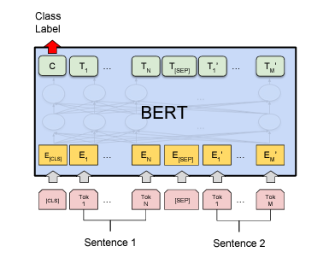
BERT for Sentence Similarity
Unsuitable for pair regression tasks
Finding existent questions on Quora most similar to new Question
Finding in a collection of n=10000 sentences the pair with the highest similarity requires with BERT n·(n−1)/2=49995000 inference computations
Possible Solution – Use BERT to get sentence Embeddings
Use the CLS token as sentence representation
Average The BERT output layer
Problem
Bad sentence embeddings, often worse than averaging GloVe embeddings
Cross-Encoder architecture

Slide 8
Siamese Network (Bi-Encoder)

Slide 9
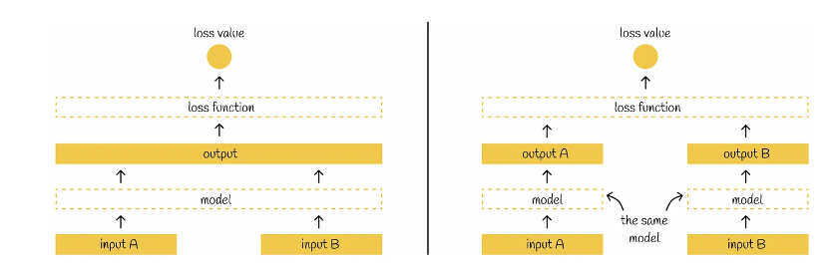
Siamese Network
Non-Siamese Network – Cross Encoder
Siamese Network – Bi-Encoder
Figure from : https://towardsdatascience.com/sbert-deb3d4aef8a4

Slide 10
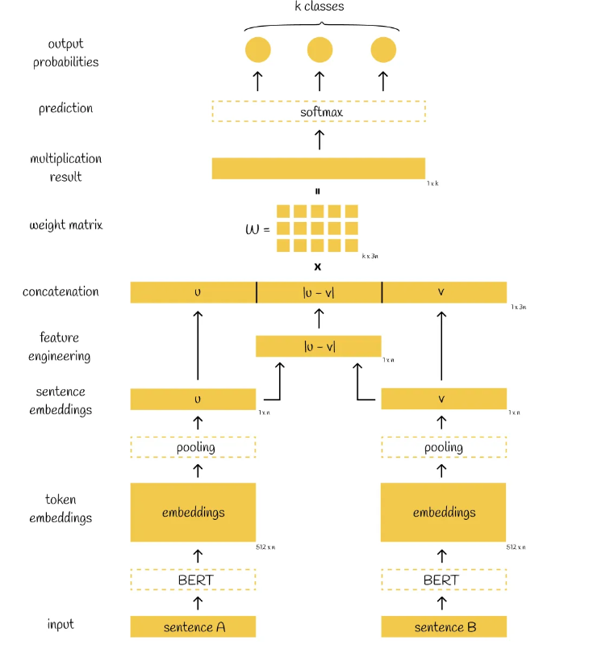
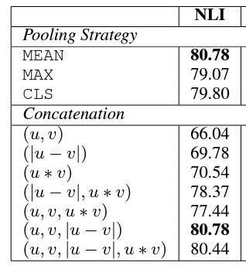
Siamese Network- Cross Entropy
K = 3 for NLI dataset
Loss function = Cross Entropy Loss function
Sentence A (Premise) | Sentence B (Hypothesis) | Label
A soccer game with multiple males playing. | Some men are playing a sport. | Entailment
A black race car starts up in front of a crowd. | A man is driving down a lonely road. | Contradiction
A smiling costumed woman is holding an umbrella. | A happy woman in a fairy costume holds an umbrella. | Neutral

Slide 11
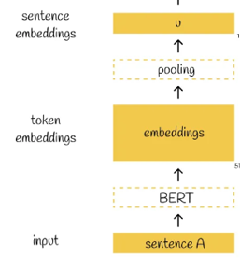
Siamese Network - Inference
Finding in a collection of n=10000 sentences the pair with the highest similarity requires with BERT (cross-encoder) n·(n−1)/2=49995000 inference computations.
On V100 GPU, the most similar sentence pair in a collection of 10,000 sentences is reduced from 65 hours with BERT to the computation of 10,000 sentence embeddings (~5 seconds with SBERT).
If your data is structured as sentence pairs and the objective is to find the similarity between only the sentence pairs, BERT will give better results than SBERT.

Slide 12
BERT vs SBERT Applications
BERT (cross-encoder) Application Examples
Customer Support Automation: BERT can be used to understand customer queries by comparing them to a fixed small set of known questions and providing precise answers, where the volume of queries is not excessively high but accuracy is crucial.
Legal Document Analysis: For comparing specific pairs of clauses or sentences in contracts to ensure compliance or detect anomalies, where the precision of the context understanding is paramount.
Quality Control in Manufacturing: BERT can analyze reports or descriptions of defects, matching them with known issues to provide accurate assessments where the dataset of known issues is finite and manageable.
SBERT (Bi-encoder) Application Examples
Semantic Search Engines: SBERT can power search engines that quickly sift through large databases of documents to find the most relevant content based on semantic similarity to the search query.
Content Recommendation Systems: SBERT can be used to match users with relevant articles, products, or services by quickly comparing user preferences or profiles with a large inventory of items.
Data Deduplication: In large databases, SBERT can efficiently identify and group similar entries, which is useful for cleaning up and organizing data in CRM systems or product catalogs.
Real-time Social Media Monitoring: For businesses that need to monitor brand mentions across social media platforms, SBERT can quickly process large volumes of data to find and categorize relevant posts.

Slide 13
Other Loss Functions for Siamese Network

Slide 14
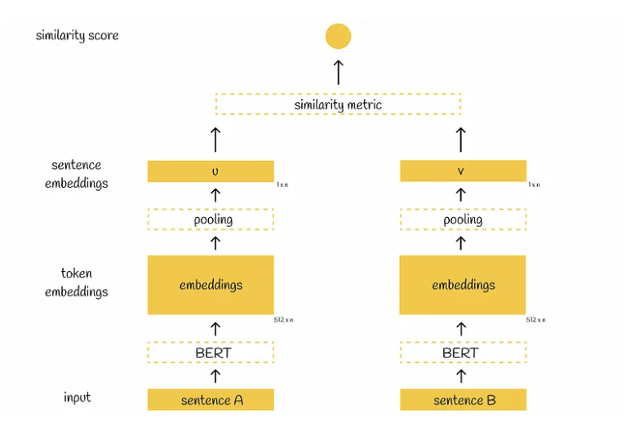
Siamese Network- Regression
Sentence A | Sentence B | Similarity Score
A woman is reading her book in the park. | A lady is enjoying a novel outdoors. | 4.2
Two dogs are running across the field. | A pair of canines are sprinting through a meadow. | 3.8
A group of people is watching a movie. | Some individuals are viewing a film together. | 3.5
Loss function = MSE

Slide 15
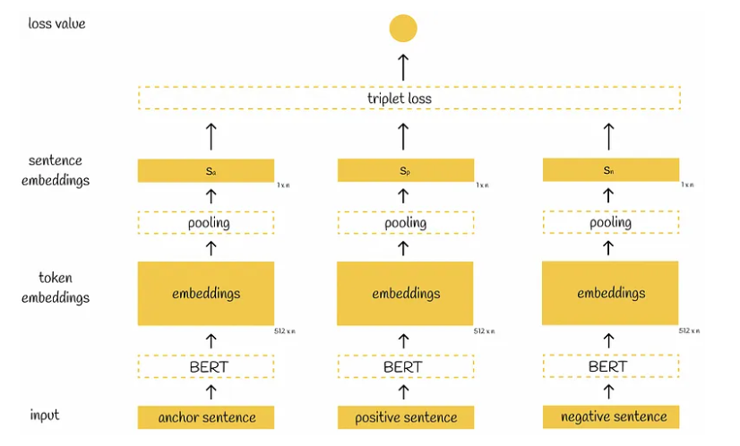

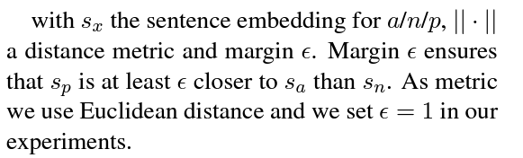
Triplet Network

Slide 16
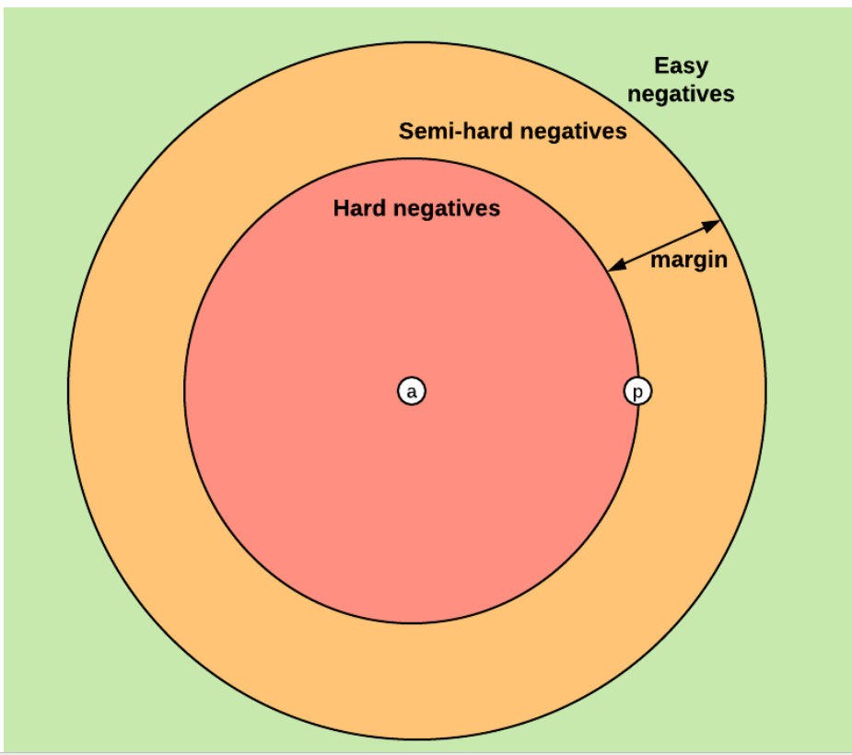
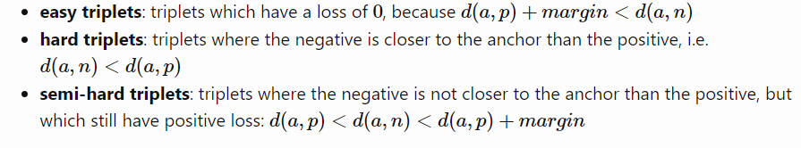
Triplet Mining
https://omoindrot.github.io/triplet-loss

Slide 17
What if we do not have negatives?
Duplicate Question Answer Dataset
What is your name? | What's your name?
Can you help me? | Could you assist me?
Where is the library? | Where can I find the library?
When does the class start? | What time does the class begin?
Duplicates
Nion-Duplicates
Nion-Duplicates
Sentence A
Sentence B

Slide 18
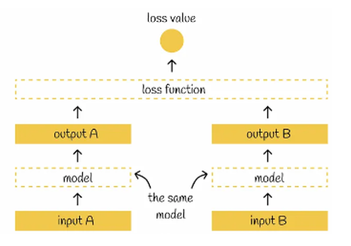
Multiple Negatives Ranking Loss
What is your name? | What's your name?
Can you help me? | Could you assist me?
Where is the library? | Where can I find the library?
When does the class start? | What time does the class begin?
Sentence A
Sentence B
Diagonals are - (Anchor, Positive)
Non-diagonals are (Anchor Negative)
0.6 | 0.3 | 0.2 | 0.1
-0.8 | 0.5 | 0.1 | 0.3
- 0.3 | -0.5 | -0.1 | -0.7
0.6 | -0.2 | 0.1 | 1.0
- Each Row will give us three pairs of (Anchor, Positive) and (Anchor, Negative)
- For each row, we can also take – Average or max or both of three (Anchor, Negative) pairs

